Slide 1
Unit 5- Lecture 32
Introduction
How brain works
Neural networks

Slide 2
Introduction
The simple arithmetic computing elements correspond to neurons—the cells that perform information processing in the brain—and the network as a whole corresponds to a collection of interconnected neurons.
For this reason, the networks are called neural networks.
Besides their useful computational properties, neural networks may offer the best chance of understanding many psychological phenomena that arise from the specific structure and operation of the brain.

Slide 3
How brain works
In about 335 B.C. Aristotle wrote, "Of all the animals, man has the largest brain in proportion to his size.“
Still, it was not until the middle of the eighteenth century that the brain was widely recognized as the seat of consciousness, and it was not until the late nineteenth century that the functional regions of animal brains began to be mapped out.
Before the nineteenth century, candidate locations for the seat of consciousness included the heart, the spleen, and the pineal body, a small appendage of the brain present in all vertebrates.
Neuron, or nerve cell, is the fundamental functional unit of all nervous system tissue, including the brain.
Each neuron consists of a cell body, or soma, that contains a cell nucleus.

Slide 4
Branching out from the cell body are a number of fibers called dendrites and a single long fiber called the axon.
Dendrites branch into a bushy network around the cell, whereas the axon stretches out for a long distance—usually about a centimeter (100 times the diameter of the cell body), and as far as a meter in extreme cases.
Eventually, the axon also branches into strands and substrands that connect to the dendrites and cell bodies of other neurons.
The connecting junction is called a synapse.
Each neuron forms synapses with anywhere from a dozen to a hundred or thousand other neurons.
Signals are propagated from neuron to neuron by a complicated electrochemical reaction.

Slide 5
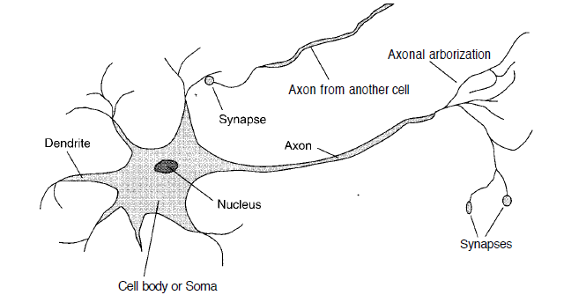

Slide 6
Chemical transmitter substances are released from the synapses and enter the dendrite, raising or lowering the electrical potential of the cell body.
When the potential reaches a threshold, an electrical pulse or action potential is sent down the axon.
The pulse spreads out along the branches of the axon, eventually reaching synapses and releasing transmitters into the bodies of other cells.
Synapses that increase the potential are called excitatory, and those that decrease it are called inhibitory.
Perhaps the most significant finding is that synaptic connections exhibit plasticity—long-term changes in the strength of connections in response to the pattern of stimulation.

Slide 7
Neurons also form new connections with other neurons, and sometimes entire collections of neurons can migrate from one place to another.
These mechanisms are thought to form the basis for learning in the brain.
The truly amazing thing is that a collection of simple cells can lead to thought, action and consciousness.

Slide 8
Brain and digital computers - Comparison
Brains and digital computers perform quite different tasks, and have different properties.
There are more neurons in the typical human brain than there are bits in a typical high-end computer workstation.
Human brain is evolving very slowly, whereas computer memories are growing rapidly.
The difference in storage capacity is minor compared to the difference in switching speed and in parallelism.
Computer chips can execute an instruction in tens of nanoseconds, whereas neurons require milliseconds to fire.
Brains more than make up for this, however, because all the neurons and synapses are active simultaneously, whereas most current computers have only one or at most a few CPUs.

Slide 9
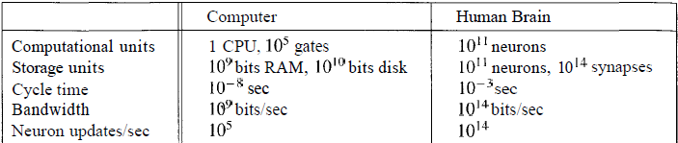
A neural network running on a serial computer requires hundreds of cycles to decide if a single neuron-like unit will fire, whereas in a real brain, all the neurons do this in a single step.
Thus, even though a computer is a million times faster in raw switching speed, the brain ends up being a billion times faster at what it does.

Slide 10
Neural networks may provide a model for massively parallel computation that is more successful than the approach of "parallelizing" traditional serial algorithms.
Brains are more fault-tolerant than computers.
A hardware error that flips a single bit can doom an entire computation, but brain cells die all the time with no ill effect to the overall functioning of the brain.
Brains are constantly faced with novel input, yet manage to do something with it.
Computer programs rarely work as well with novel input, unless the programmer has been exceptionally careful.

Slide 11
The third attraction of neural networks is graceful degradation: they tend to have a gradual rather than sharp drop-off in performance as conditions worsen.
The final attraction of neural networks is that they are designed to be trained using an inductive learning algorithm.
After the network is initialized, it can be modified to improve its performance on input/output pairs.
To the extent that the learning algorithms can be made general and efficient, this increases the value of neural networks as psychological models, and makes them useful tools for creating a wide variety of high-performance applications.

Slide 12
Neural network
A neural network is composed of a number of nodes, or units, connected by links.
Each link has a numeric weight associated with it.
Weights are the primary means of long-term storage in neural networks, and learning usually takes place by updating the weights.
Some of the units are connected to the external environment, and can be designated as input or output units.
The weights are modified so as to try to bring the network's input/output behavior more into line with that of the environment providing the inputs.

Slide 13
Each unit has a set of input links from other units, a set of output links to other units, a current activation level, and a means of computing the activation level at the next step in time, given its inputs and weights.
The idea is that each unit does a local computation based on inputs from its neighbors, but without the need for any global control over the set of units as a whole.
Most neural network implementations are in software and use synchronous control to update all the units in a fixed sequence.
To build a neural network to perform some task, one must first decide how many units are to be used, what kind of units are appropriate, and how the units are to be connected to form a network.

Slide 14
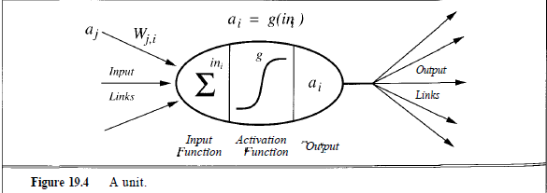
One then initializes the weights of the network, and trains the weights using a learning algorithm applied to a set of training examples for the task.
The use of examples also implies that one must decide how to encode the examples in terms of inputs and outputs of the network.
Next slide shows various mathematics notations used in neural network.

Slide 15
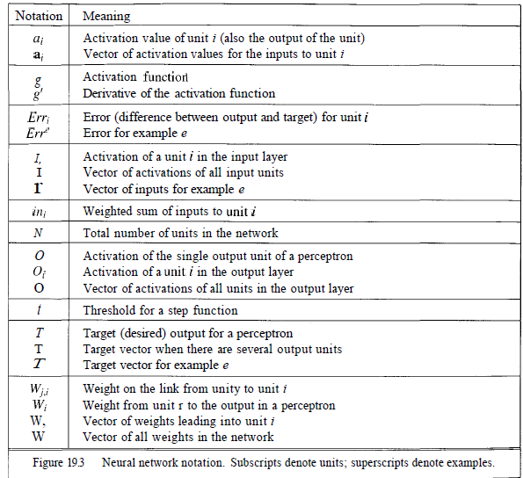

Slide 16
Each unit performs a simple computation: it receives signals from its input links and computes a new activation level that it sends along each of its output links.
The computation of the activation level is based on the values of each input signal received from a neighboring node, and the weights on each input link.
The computation is split into two components.
First is a linear component, called the input function, in_{i}, that computes the weighted sum of the unit's input values.
Second is a nonlinear component called the activation function, g, that transforms the weighted sum into the final value that serves as the unit's activation value, a_{i}.

Slide 17

Usually, all units in a network use the same activation function.
The total weighted input is the sum of the input activations times their respective weights:
where the final expression illustrates the use of vector notation.
In this notation, the weights on links into node i are denoted by W, the set of input values is called a_{i}, and the dot product denotes the sum of the pairwise products.

